Slide 1

PROJECT TITLE Firmware Development and Testing using QEMU
by
Varsha V Devagiri | 221039016
Arjun M Krishna | 221039024
Under the guidance of
Dr. Mohan Kumar J (Associate Professor)
Manipal School of Information Science

Slide 2
Presentation Outline
Introduction
Literature Review
Objectives
4. Block Diagram
5. Methodology
6. Result Analysis
Conclusion & Future Work
Timeline Chart
9. References

Slide 3
1. Introduction
Industrial Automation have complex software systems
The scope and complexity of software components has gone up significantly.
Embedded software development is inherently dependent on hardware availability.
Hardware development is time consuming, iterative and unpredictable.
Application development and verification should be taken care by the time the hardware is finalized and delivered to the software developers.
With advanced hardware emulators and virtual machines, embedded software developers can get a head start on their applications.

Slide 4
Firmware :
Firmware is a program that provides a control for a specific hardware device and gives instructions for how that device communicates with other computer hardware.
Code that manages the sensors, peripherals, motors, and timers in devices
QEMU (Quick EMUlator) :
General-purpose, open-source machine emulator and virtualizer.
It can run OS and applications designed for one machine (ARM board) on another as a device emulator (own PC).
It can emulate complete machine in software without having actual hardware.

Slide 5
Why QEMU?
QEMU is used for the emulation of the Raspberry Pi, router firmware etc. It was chosen on the following considerations.
• QEMU supports MPC603e core processor emulation
• QEMU supports both x86-Windows and x86- Linux as host machines
• QEMU is an active open source project with a good developer community and support

Slide 6
2. Literature Review
Authors and Title | Purpose of Study | Key Findings
1) ‘Implement a virtual development platform based on QEMU’ by Xiao Xiao Bian | This paper looks for full system emulation and study the architecture and internals of QEMU. | Build convenient environment which is used to develop, test & debug target code without access to target hardware
2) ‘Efficient embedded software development using QEMU’ by Pradyumna Sampath, Rachana Rao | This paper looks at employing virtualization for in-house real-time application software development through QEMU, a popular open source emulator. | Virtualization provides the ability to simulate components like load generators, performance monitors and other resources beyond the scope of a usual test setup.

Slide 7
3. Objectives
Objectives:
To learn and understand the working of QEMU emulator.
To emulate the available Firmware (Router/Any boards) on the QEMU emulator.
To create an application for the emulated firmware.

Slide 8
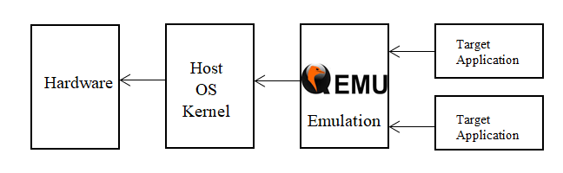
4. Block Diagram
The two main components are the host machine and the target machine.
The target - system that we wish to emulate.
The host - machine that is used to build the target software.
Here the host machine is Linux kernel and the target machine is Raspbian OS

Slide 9
5. Methodology
Emulation of Raspbian OS on QEMU:
Step 1: First, we installed the latest Ubuntu version .
Step2: For the QEMU emulation we need the following:
- A Raspbian Image
- Latest qemu kernel
Step 3: Inside the Ubuntu VM, we created a new folder and placed the Raspbian Jessie image and qemu-kernel into the folder created.
Step 4: We emulated Raspbian OS on QEMU by following few linux commands.
Here we see the GUI of Raspbian OS (Target application) from the Ubuntu System (Host).

Slide 10
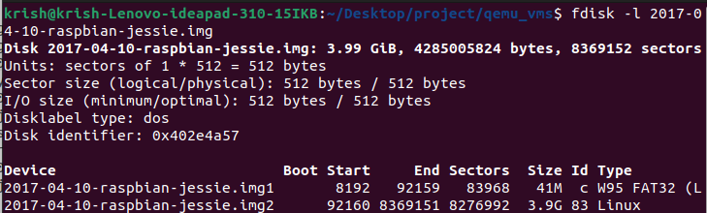
The Raspbian OS needs to be setup and emulated on QEMU using certain set of linux commands as shown below.
Ubuntu will be used to imitate the desired ARM
fdisk is used to prepare and partition a brand new hardware. fdisk -l lists out all the options available for fdisk

Slide 11

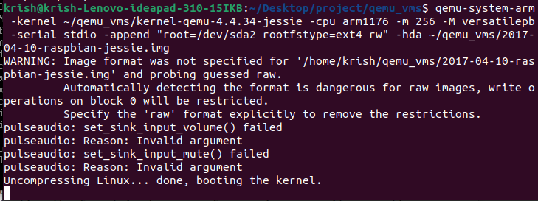

Slide 12
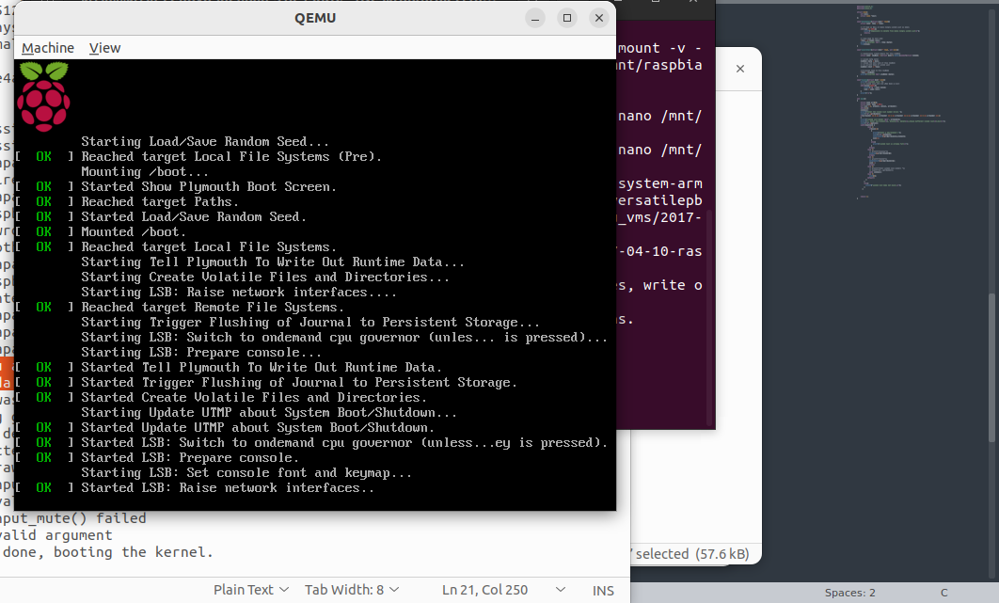
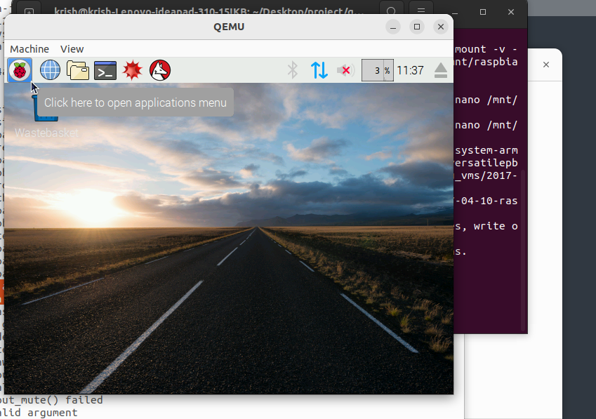

Slide 13
6. Result Analysis
Advanced Networking
Can Access to port on the VM you are running in QEMU.
Construct a shared network interface (tap0) for this purpose, enabling us to access all open ports
Commands on HOST (Ubuntu) system:
$ sudo apt-get install uml-utilities
$ sudo tunctl -t tap0 -u <host-name>
$ sudo ifconfig tap0 172.16.0.1/24
$ ifconfig tap0
Start QEMU VM and assign an IP to its eth0 interface
$ sudo ifconfig eth0 172.16.0.2/24
We were able to reach open ports on the GUEST (Raspbian) from your HOST (Ubuntu) system

Slide 14
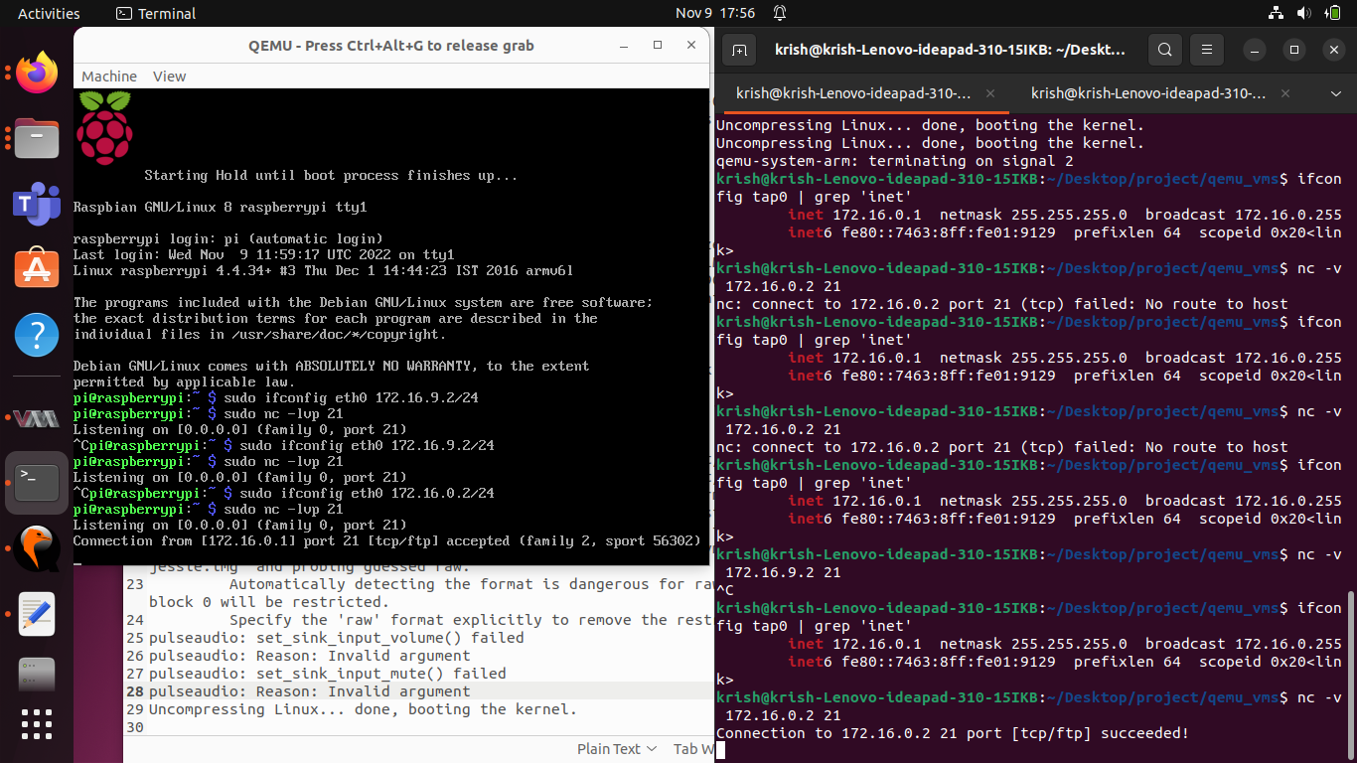
6. Result Analysis Cont..

Slide 15
Container:
Standard unit of software that packages up code and all its dependencies so the application runs quickly and reliably from one computing environment to another.
Hypervisor:
A hypervisor, also known as a virtual machine monitor or VMM, is software that creates and runs virtual machines
Docker:
Docker is an open source software platform to create, deploy and manage virtualized application containers on a common operating system

Slide 16
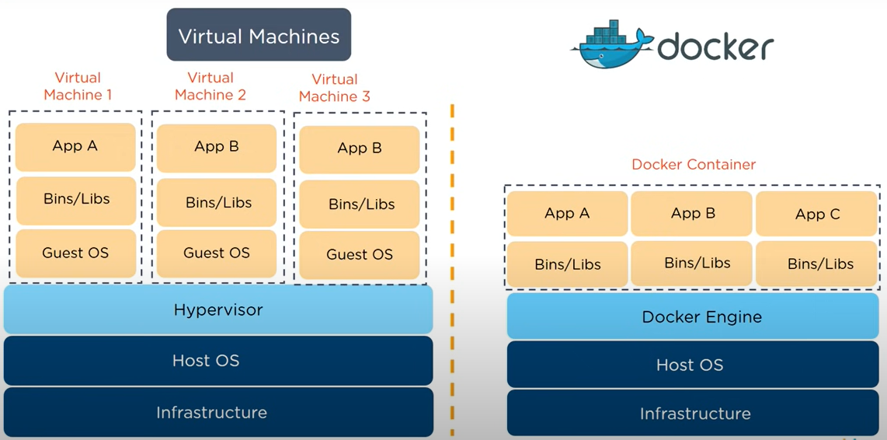

Slide 17
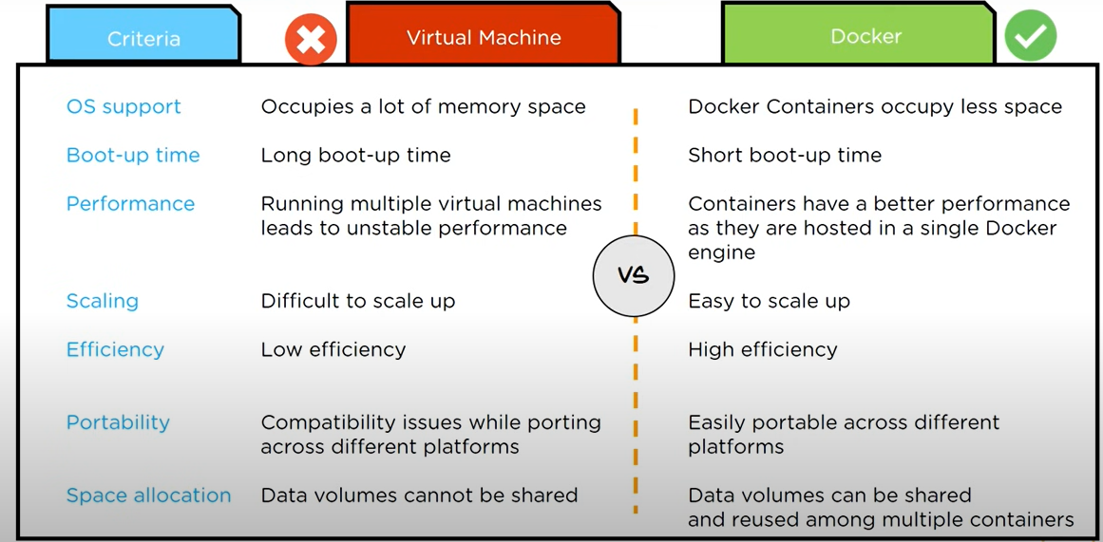

Slide 18
Emux Docker Image
The EMUX Firmware Emulation Framework is a collection of scripts, kernels and file systems to be used with QEMU to emulate ARM and MIPS Linux IoT devices
It uses qemu-system-arm, qemu-system-mips to boot up virtual ARM and MIPS Linux environments
Volume harambe containing the /emux directory tree.
Container emux-docker
Three executable files:
./build-emux-volume
./build-emux-docker
./run-emux-docker

Slide 19
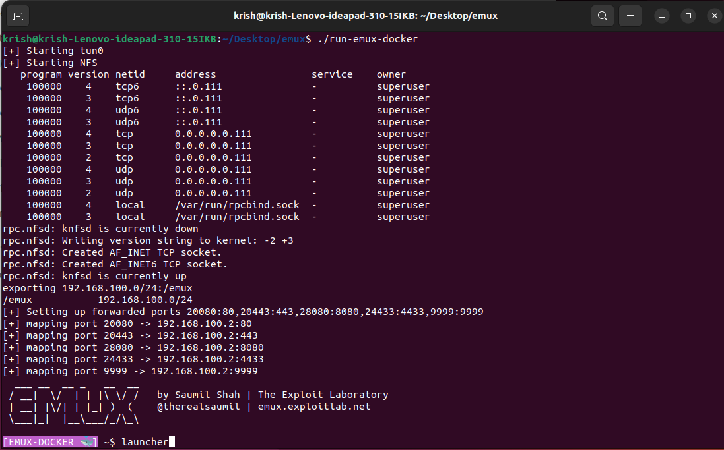
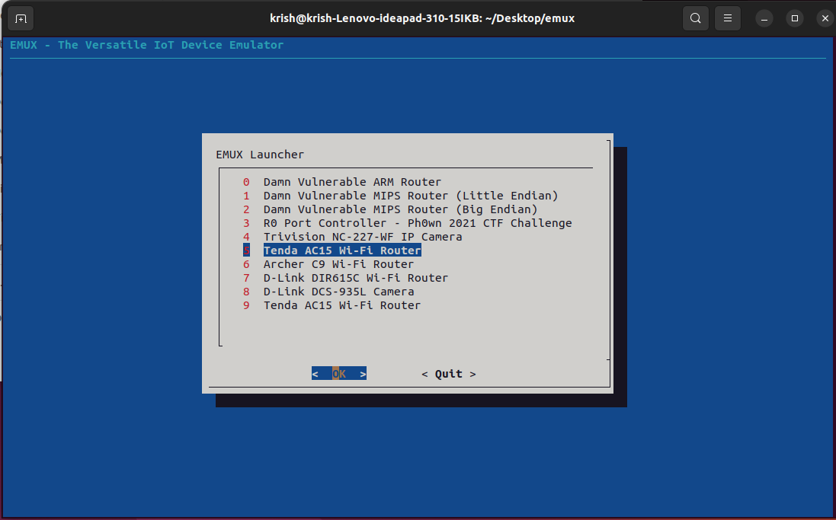

Slide 20
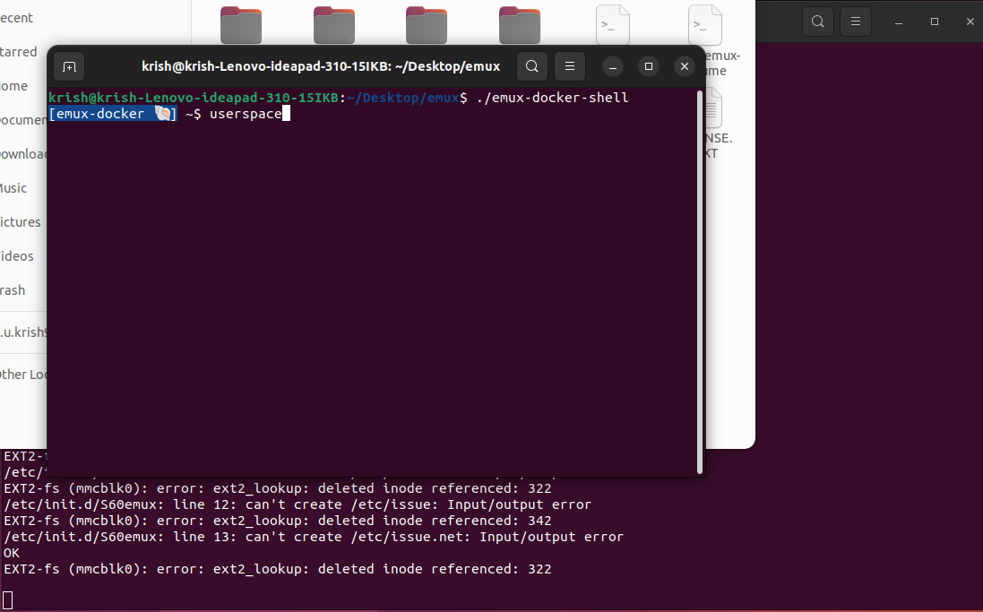
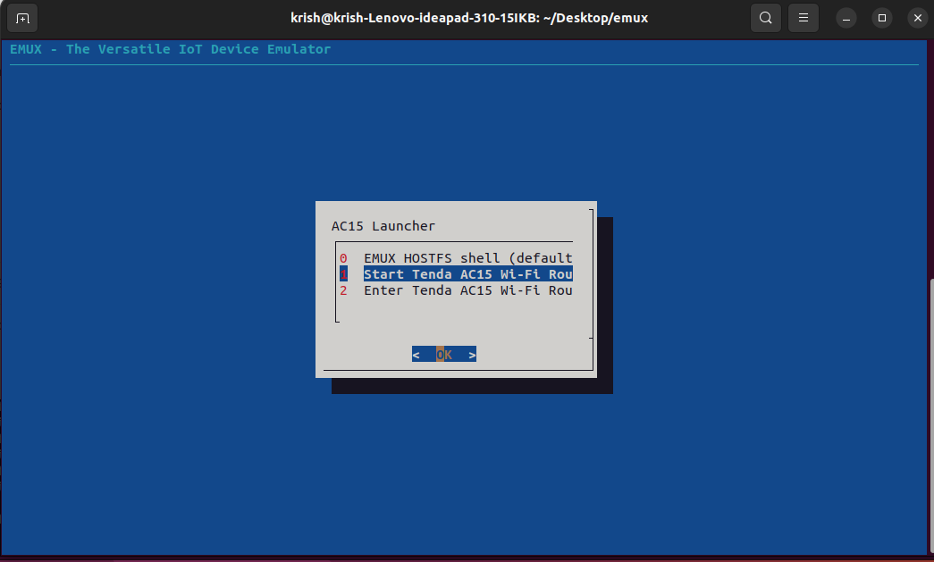


Slide 21
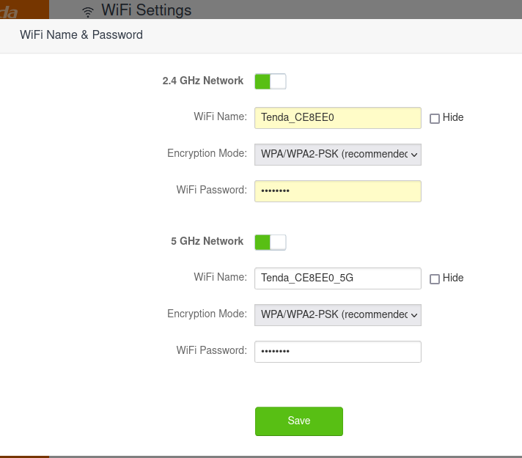
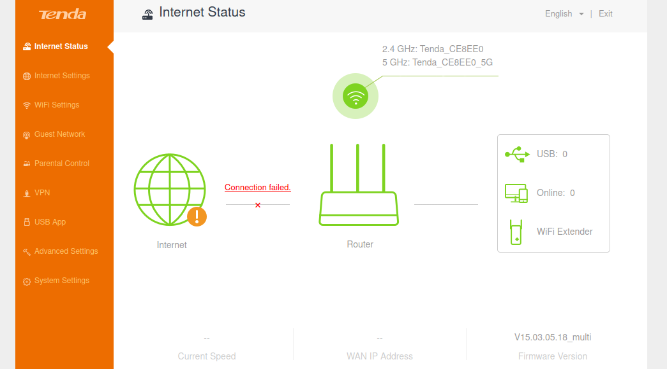

Slide 22
7. Conclusion and Future work
Conclusion
Qemu plays an important role in the emulation of different kind of firmware and it is important in the field of Embedded application development.
Since it is very hard to procure the necessary hardware required to build applications, emulating the same hardware qemu is very efficient
Docker is a tool designed to make it easier for developers to develop, ship, and run applications by using containers.
Containers allow devs to package an application with all of its requirements and configurations, such as libraries and other dependencies and deploy it as a single package

Slide 23
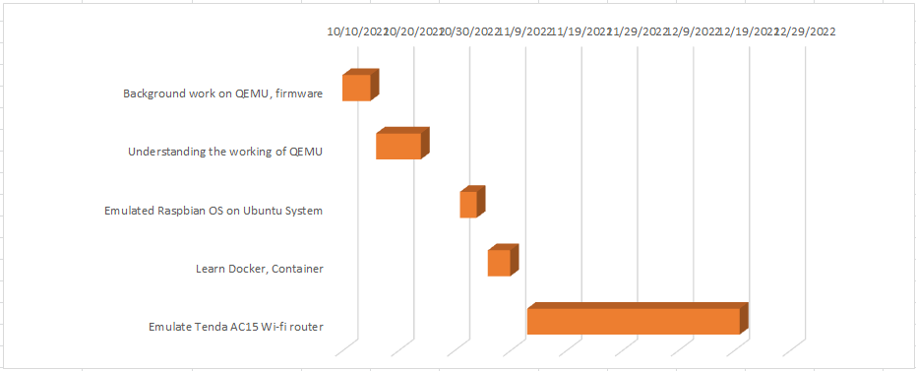
8. Timeline Chart

Slide 24
9. References
[1] F. Bellard, "QEMU a Fast and Portable Dynamic Translator", Proceedings of USENIX Annual Technical Conference, pp. 41-46, June 2005.
[2] Y. Chen, J. Ren, H. Zhu and Y. C. Shi, "Dynamic binary translation and optimization in a whole-system emulator -SkyEye", International Conference on Parallel Processing Workshops, pp. 329-336, August 2006.
[3] Xiao Xiao Bian, “Implement a Virtual Development Platform Based on QEMU”,2017 International Conference on Green Informatics (ICGI).
[4] Available: https://azeria-labs.com

Slide 25
Queries
&
Suggestions

Slide 26
THANK YOU…

